Slide 1





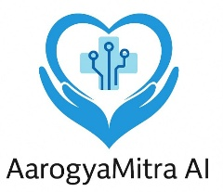





AarogyaMitra AI
AarogyaMitra AI – Your Voice-First GenAI Companion for Health Diagnosis & Insurance Literacy
2025

Slide 2
Table Of Contents
About Us
Stats & Numbers
Problem Statement
Market Impact and Buyers
Competitor Landscape
Pricing
Call to Action
Our Solution Features
Technology Stack

Slide 3

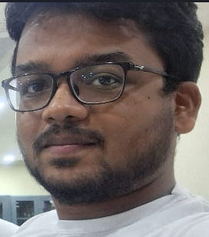

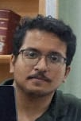
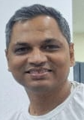
Meet Our Team
Subhadeep Mondal ,
Developer
Ayan Satt
Developer
Rohan Bhowmik
Developer
Rajat Pal
Solution Architect
5 years experienced in AI/ML Developer
2 years experienced in web development
2 years experience in Cloud, DevOps, Python
25 years experience in IT, AI/GenAI , Business Strategy, Solution Architect, Product Strategy

Slide 4

90% of insured Indians don’t understand their policies – leading to claim rejections and mistrust. (Source: PolicyBazaar survey, 2022)
Complex medical reports and prescriptions leave users confused about diagnosis.83% of rural Indians struggle with digital text-based apps. (Source: IAMAI Digital India report, 2023)
India has only 1 claims advisor per 20,000 insured in Tier 2/3 cities. (IRDAI Annual Report)
Problem Statement
Challenge: How can we use GenAI to help patients easily understand their diagnosis, know what’s covered in their health insurance, and file claims smoothly—especially in their own language?

Slide 5
1. Symptom-to-Policy Coverage Assistant
2. OCR + Diagnosis Extraction from Prescriptions
3. Voice-first Bharat Assistant
4. Claim Filing Guidance
5. Centralized Admin Portal & Evaluation and Feedback Cycle
Key Features (Overview)
All integrated into a lightweight GenAI app

Slide 6
User enters symptoms (text/voice) or uploads a Prescription.
GenAI maps symptoms to ICD-10 disease diagnosis using medical LLMs.
Matches diagnosis to user’s health policy terms (via IRDAI/insurer-specific rules).
Displays simple output: e.g., “Your policy covers this under daycare.” and also gives reasoning behind if not covered
Feature 1 – Symptom-to-Policy Coverage Assistant
✅ Financial empowerment ✅ Diagnosis + eligibility in one click

Slide 7
User uploads doctor prescription or lab report (PDF/image).
OCR extracts relevant text using Tesseract/DocTR.
GenAI summarizes diagnosis in plain language.
Matches result with insurance policy coverage.
Answers queries in simple English
Feature 2 – OCR + Diagnosis from Prescription / Lab Report
✅ No need to decode medical jargon ✅ Instant answer: “Covered” / “Not Covered”

Slide 8
Speak in Hindi, Tamil, Marathi: “मुझे दावा कैसे करना है?”
Whisper (open-source) converts voice to text.
GenAI + NLU interprets query.
Retrieves policy-specific help or coverage detail.
Feature 3 – Voice-First Bharat Assistant, (Multilingual)
✅ Inclusive, accessible ✅ Trusted experience for 70 crore Indians

Slide 9
Through a user-friendly chat interface either text or voice users asks any assistance needed while filing claim
The queries can be from complex scenarios for which getting answer directly from the claim filing manual can be tough
The responses are detailed with clear analysis for the scenario
Feature 4 – Claim Filing Guidance
✅ Simplified Claim Filing Assist ✅ Enabling members filing their claim with confidence

Slide 10
The Platform owners uploads all health insurance portal help document as soon as they are updated in respective insurers portal.
Through a Centralized Dashboard they monitor the critical business statistics to measure the benefit realized by the end users
To get the intelligent insights when there are negative statistics w.r.t user metrics for a hospital and take corrective actions accordingly
Feature 5 –
Centralized Admin Portal & Evaluation and Feedback Cycle
✅ Continuous Platform Monitoring and Customer Feedback ✅ Dissemination of information w.r.t Claim Filing as soon there are any changes in insurers portal for filing claim

Slide 11
Frontend: Streamlit (Open Source)
Backend: Python, FastAPI, LangChain, (Open Source)
GenAI Models: Grok (LLMA3.1 and Mistral)
OCR: Tesseract, (Open Source)
Speech-to-Text: Whisper by OpenAI (Free + Open Source)
Translation Layer: IndicTrans2 or MarianMT (Open Source)
Vector DB: FAISS (Open Source)
Document Parsing: PyMuPDF, pdfminer.six (Open Source)
RAG Layer: LangChain using local embeddings on IRDAI policy PDFs
Technology Stack (Fully Open Source)
✅ No paid APIs required ✅ Lightweight, local deployment possible

Slide 12
Primary Buyers:
Insurance companies (Star Health, Niva Bupa, Aditya Birla Health)
TPAs & Brokers
Ayushman Bharat / PM-JAY / State Health Missions
Why they’ll buy:
Reduces rejected claims
Increases customer literacy and trust
Enables policy stickiness and digital engagement
Market Impact & Buyers of this Platform
✅ TAM (Total Addressable Market): ₹50,000+ Cr Indian Health Insurance industry growing at 18% CAGR

Slide 13
Platform | Focus Area | GenAI Use | Voice/Local Language | Policy Integration | Open Source | Cost
PlumHQ | B2B Group Insurance | ❌ | ❌ | Limited | ❌ | Paid SaaS
Digit Insurance | App-based insurance | ❌ | ❌ | Limited | ❌ | Paid SaaS
HealthPlix, DocsApp | Doctor-patient diagnosis | ✅ (basic) | ❌ | ❌ | ❌ | Paid
AarogyaMitra AI | Diagnosis + Insurance awareness | ✅ Advanced | ✅ Multilingual | ✅ Deep IRDAI RAG | ✅ | Free/Open Source
Competitor Landscape
✅ TAM (Total Addressable Market): ₹50,000+ Cr Indian Health Insurance industry growing at 18% CAGR

Slide 14
Open Source Edition:
Free to use for developers, TPAs, and health-tech innovators
SaaS Edition (Optional): ₹99/month/user for insurance companies with branded policy integration, analytics, and voice hosting
Custom Integration: ₹2–5 L per org for custom IRDAI rule ingestion + multilingual tuning
Pricing & GTM Strategy for the Platform Owners
✅ Revenue Potential:
10 insurance clients × ₹5L integration = ₹50L
1L active users × ₹99/month = ₹99L/month = ₹11.8Cr/year

Slide 15
IRDAI push for paperless, inclusive claims
GenAI now powerful enough to interpret and simplify policy docs
Digital health records & wearables growing
2025: Year of GenAI-powered Bharat assistants
Why Now?

Slide 16
Let’s demo the future of diagnosis + insurance in one tool
Build AarogyaMitra AI in 24 hours with:
Sample insurer PDFs
Prescriptions
Voice inputs
Call to Action
✅ Built for India. Built for impact. Powered by GenAI.

Slide 17

"True healthcare is not just about treating illness, but empowering people to understand their well-being."— Dr. Devi Shetty
— Renowned Indian cardiac surgeon and healthcare entrepreneur

Slide 18
02.
Demo
AarogyaMitra AI – Your Voice-First GenAI Companion for Health Diagnosis & Insurance Literacy

Slide 19
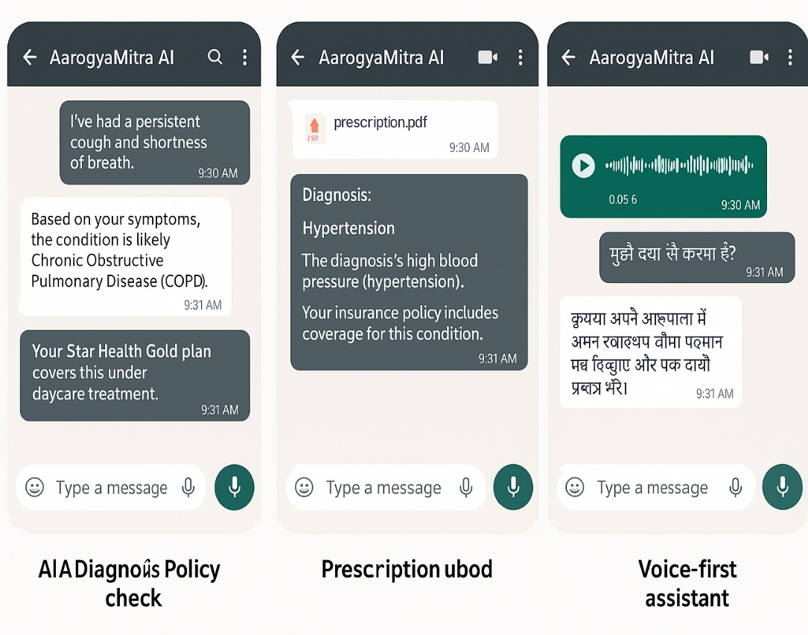
A picture is worth a thousand words
AarogyaMitra AI – Your Voice-First GenAI Copilot for Health Diagnosis & Insurance Literacy

Slide 20
Thank You
"Understanding your health and your rights shouldn't require a translator or a lawyer. In a country of a billion dreams, healthcare clarity must be a birthright."

